Slide 1
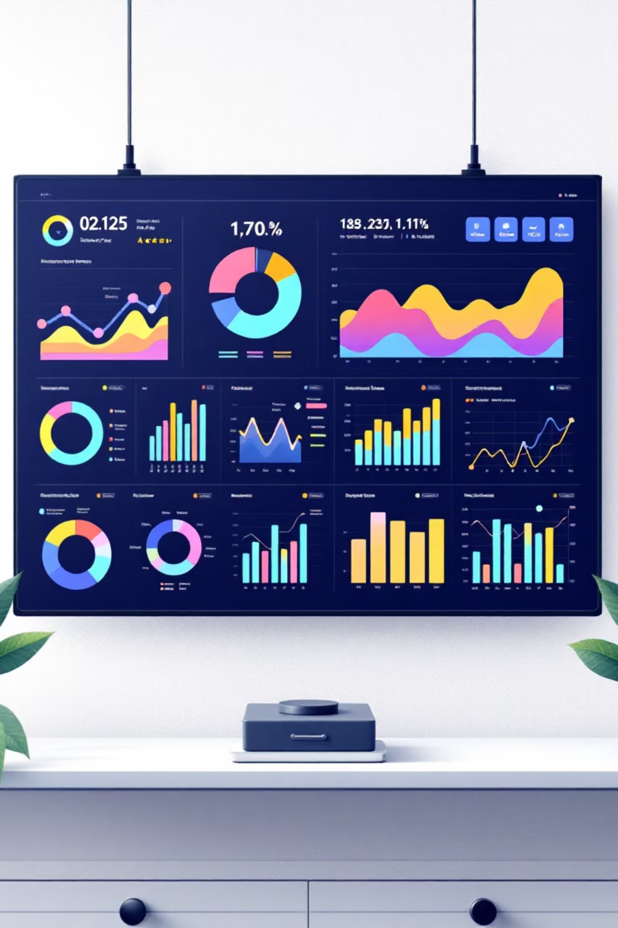
Customer Shopping Behavior Analysis
Uncovering insights from 3,900 purchases to guide strategic decisions

Slide 2

OVERVIEW
Project Scope
3.9K
18
4
Total Purchases
Data Points
Categories
Transactions analyzed
Features per customer
Product segments
Analyzing spending patterns, customer segments, and subscription behavior across demographics and product preferences.
Project~

Slide 3


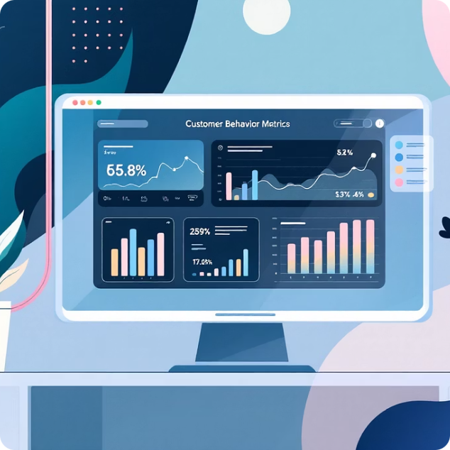

DATA FOUNDATION
Dataset at a Glance
Demographics
Purchase Details
Shopping Behavior
Age, gender, location, subscription status
Item, category, amount, season, size, color
Discounts, reviews, frequency, shipping preferences
Only 37 missing values in Review Rating column—imputed using category medians
Project~

Slide 4






PYTHON
Data Preparation Process
Cleaning
Load Data
Handle Missing
Import CSVs and tables
Impute or drop values
Standardized columns, imputed missing ratings
Engineering
Created age groups and frequency metrics
Explore Structure
Engineer Features
Inspect columns and types
Create groups and metrics
Integration
Loaded into PostgreSQL for SQL analysis
Systematic approach ensuring data quality and consistency for analysis.
Project~

Slide 5


SQL ANALYSIS
Key Business Insights
01
Revenue by Gender
Male customers: $157K vs Female: $75K
02
High-Value Discount Users
839 customers spent above average despite discounts
03
Top Products
Gloves (3.86), Sandals (3.84), Boots (3.82) highest rated
04
Shipping Preferences
Express ($60.48) vs Standard ($58.46) average spend
Project~

Slide 6
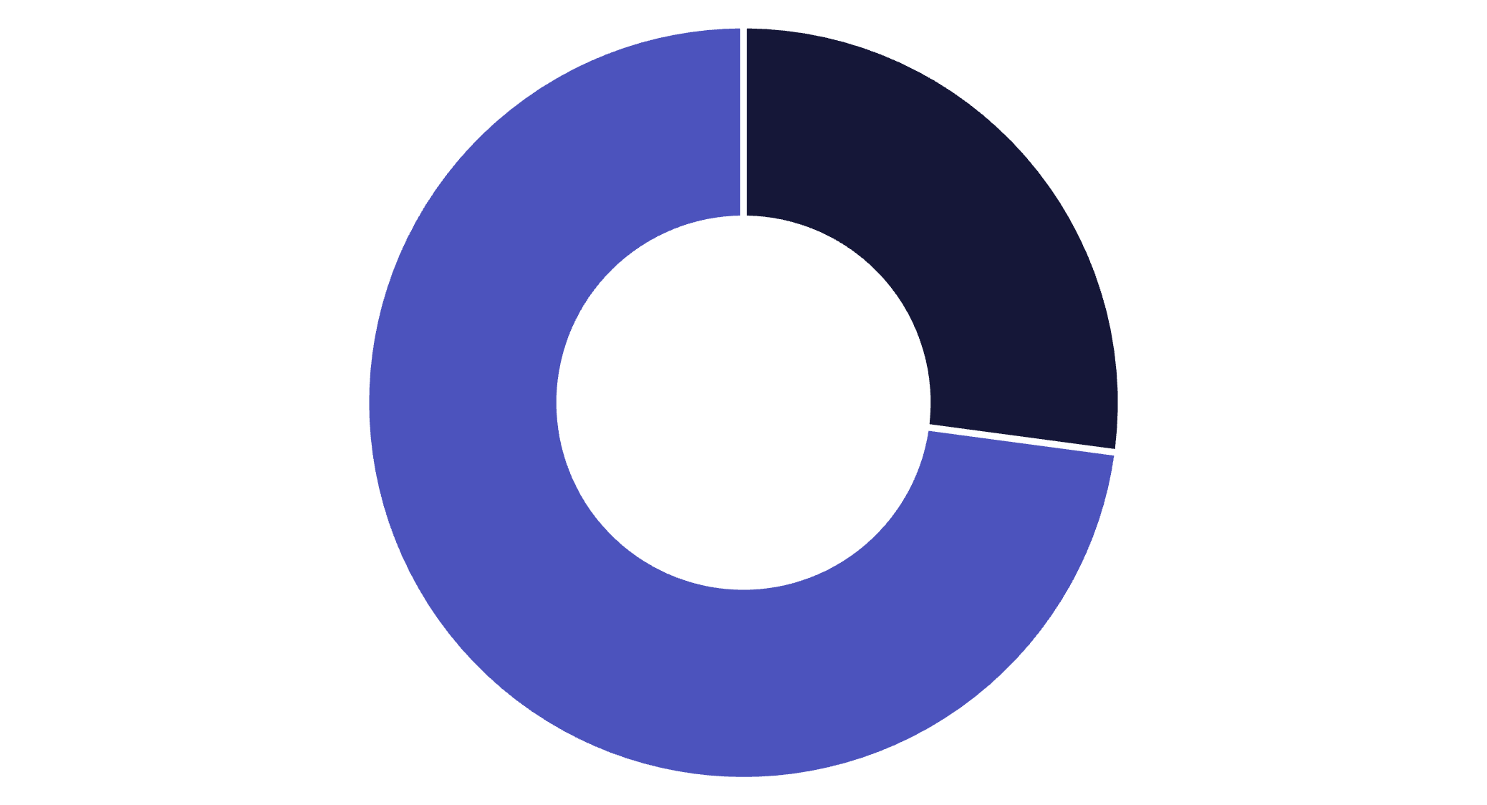


Subscription Impact Analysis
Subscribers
Non-Subscribers
27% Subscribe
$59.49
$59.87
Subscriber Spend
Non-Subscriber Spend
Project~
Similar spending patterns, but subscribers generate $62.6K total revenue vs $170.4K from larger non-subscriber base.

Slide 7
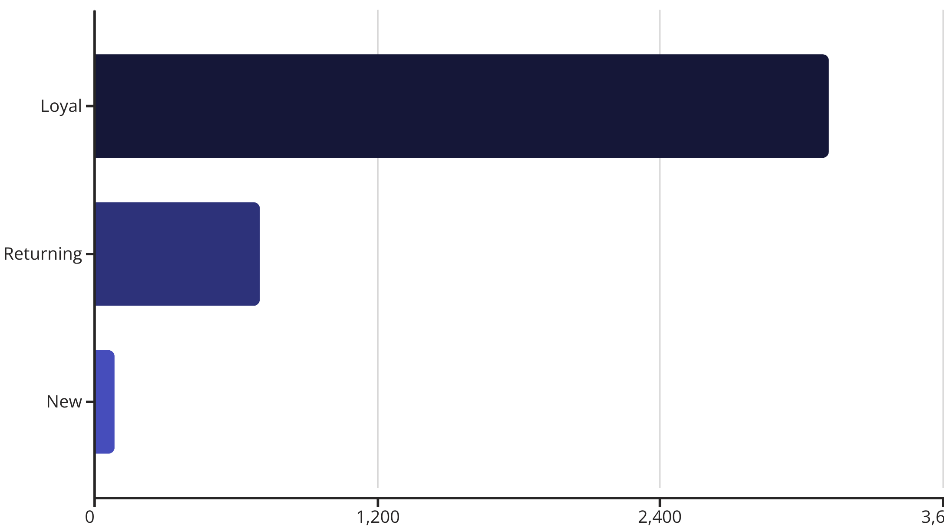
Customer Segmentation
80% Loyal Base
Strong retention with 3,116 loyal customers. Opportunity to convert 701 returning customers into loyal segment.
958 repeat buyers (>5 purchases) show higher subscription rates.
Project~

Slide 8


DASHBOARD
Power BI Visualization
Revenue by Category
Age Group Performance
Key Metrics
Clothing leads at $100K, followed by Accessories $70K
Young Adults contribute $62K, highest revenue segment
$59.76 avg purchase, 3.75 avg rating across 3.9K customers
Project~

Slide 9

Discount Strategy Insights
50% Discount Rate
Top discount-dependent products:
Hats (50%)
Sneakers (49.66%)
Coats (49.07%)
Sweaters (48.17%)
Pants (47.37%)
Balance needed: 839 high-spenders use discounts but maintain above-average purchases.
Project~

Slide 10

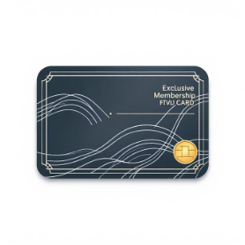

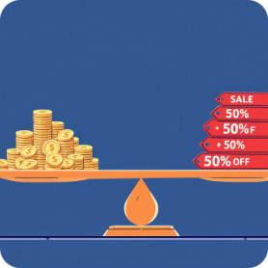

ACTION PLAN
Strategic Recommendations
Boost Subscriptions
Loyalty Programs
Optimize Discounts
Targeted Marketing
Reward 701 returning buyers to move into loyal segment
Review 50% discount rates while protecting margins
Focus on Young Adults ($62K revenue) and express shipping users
Promote exclusive benefits to convert 73% non-subscribers
Project~

